Slide 1
공개 소프트웨어 프로젝트
Team 10 : Smart Album
with Cloud

Slide 2




Open Source – APhotoManager
Github
- https://github.com/k3b/APhotoManager
License – GNU General Public license
The licenses for most software and other practical works are designed
to take away your freedom to share and change the works. By contrast,
the GNU General Public License is intended to guarantee your freedom to
share and change all versions of a program--to make sure it remains free
software for all its users. We, the Free Software Foundation, use the
GNU General Public License for most of our software; it applies also to
any other work released this way by its authors. You can apply it to
your programs, too.

Slide 3
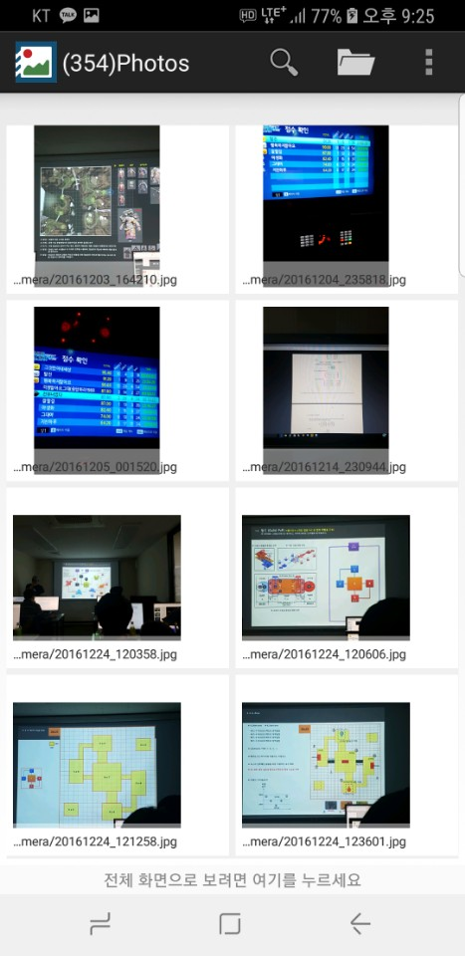
Open Source – APhotoManager
* Options
Arrangement by :
Location
Time
Name
Map View

Slide 4
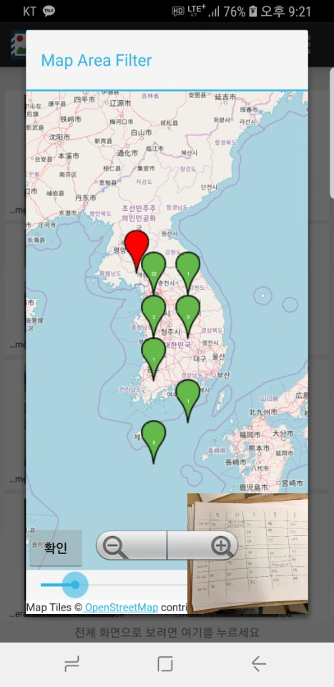
Open Source – APhotoManager
* Options
Arrangement by :
Location
Time
Name
Map View

Slide 5
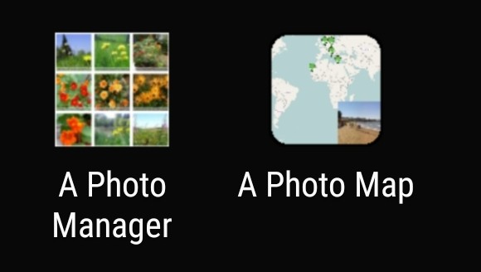
Open Source – APhotoManager
* Problems
- Two APK files to be Installed
- Unfriendly UI : Map views, Settings, etc
* Our New Features
- Automated Cloud Synchronization
- Facial Recognition Classification

Slide 6
Smart Album with Cloud : Use Case Diagram

Slide 7



Next Week
Specify Each Function
with Open API Library
UI Design & Function Matching

Slide 8
Thank You
Team 10 : Smart Album
with Cloud

